Slide 1
Pulse Code Modulation and Delta Modulation

Slide 2
ANALOG-TO-DIGITAL CONVERSION
Modulation is the process of varying one or more parameters of a carrier signal in accordance with the instantaneous values of the message signal.
The message signal is the signal which is being transmitted for communication and the carrier signal is a high frequency signal which has no data, but is used for long distance transmission.

Slide 3
Pulse Code Modulation (PCM)
The most common technique to change an analog signal to digital data (digitization) is called pulse code modulation (PCM)
1. The analog signal is sampled.
2. The sampled signal is quantized.
3. The quantized values are encoded as streams of bits.
The transmitter section of a Pulse Code Modulator circuit consists of Sampling, Quantizing and Encoding, which are performed in the analog-to-digital converter section. The low pass filter prior to sampling prevents aliasing of the message signal.

Slide 4
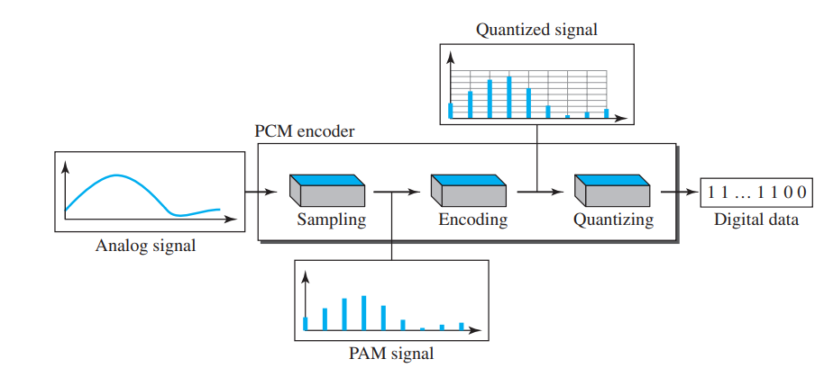

Slide 5
Sampler
This is the technique that helps to collect the sample data at instantaneous values of message signal, so as to reconstruct the original signal. The sampling rate must be greater than twice the highest frequency component W of the message signal, in accordance with the sampling theorem. According to the Nyquist theorem, to reproduce the original analog signal, one necessary condition is that the sampling rate be at least twice the highest frequency in the original signal
In ideal sampling, pulses from the analog signal are sampled and cannot be easily implemented.
In natural sampling, a high-speed switch is turned on for only a small period of time when the sampling occurs. The result is a sequence of samples that retains the shape of the analog signal.
The most common sampling method, called sample and hold, however, creates flat-top samples by using a circuit.

Slide 6
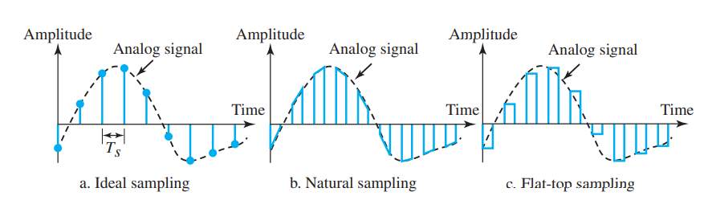

Slide 7
Problem
A complex bandpass signal has a bandwidth of 200 kHz. What is the minimum sampling rate for this signal?
Solution
We cannot find the minimum sampling rate in this case because we do not know where the bandwidth starts or ends. We do not know the maximum frequency in the sig

Slide 8
A complex low-pass signal has a bandwidth of 200 kHz. What is the minimum sampling rate for this signal?
Solution
The bandwidth of a low-pass signal is between 0 and f, where f is the maximum frequency in the signal. Therefore, we can sample this signal at 2 times the highest frequency (200 kHz). The sampling rate is therefore 400,000 samples per second.

Slide 9

Quantizer
Quantizing is a process of reducing the excessive bits and confining the data. The sampled output when given to Quantizer, reduces the redundant bits and compresses the value.
The following are the steps in quantization:
1. We assume that the original analog signal has instantaneous amplitudes between Vmin and Vmax.
2. We divide the range into L zones, each of height Δ (delta).
3. We assign quantized values of 0 to L − 1 to the midpoint of each zone.
4. We approximate the value of the sample amplitude to the quantized values
.

Slide 10
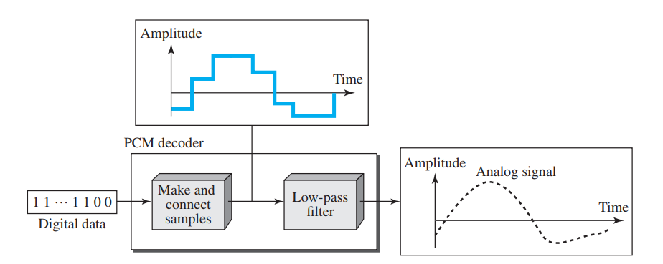
Encoder
The digitization of analog signal is done by the encoder. It designates each quantized level by a binary code. The sampling done here is the sample-and-hold process.

Slide 11
The recovery of the original signal requires the PCM decoder. The decoder first uses circuitry to convert the code words into a pulse that holds the amplitude until the next pulse.
After the staircase signal is completed, it is passed through a low-pass filter to smooth the staircase signal into an analog signal.
The filter has the same cutoff frequency as the original signal at the sender.
If the signal has been sampled at (or greater than) the Nyquist sampling rate and if there are enough quantization levels, the original signal will be recreated

Slide 12
Delta Modulation (DM)
PCM is a very complex technique.
Other techniques have been developed to reduce the complexity of PCM. The simplest is delta modulation.
PCM finds the value of the signal amplitude for each sample; DM finds the change from the previous sample

Slide 13
Modulator
The modulator is used at the sender site to create a stream of bits from an analog signal.
The process records the small positive or negative changes, called delta δ.
If the delta is positive, the process records a 1; if it is negative, the process records a 0.
However, the process needs a base against which the analog signal is compared.
The modulator builds a second signal that resembles a staircase. Finding the change is then reduced to comparing the input signal with the gradually made staircase signal.

Slide 14
The modulator, at each sampling interval, compares the value of the analog signal with the last value of the staircase signal.
If the amplitude of the analog signal is larger, the next bit in the digital data is 1; otherwise, it is 0.
The output of the comparator, however, also makes the staircase itself. If the next bit is 1, the staircase maker moves the last point of the staircase signal δ up; if the next bit is 0, it moves it δ down.

Slide 15
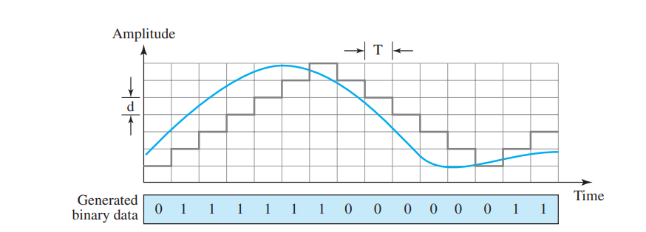

Slide 16
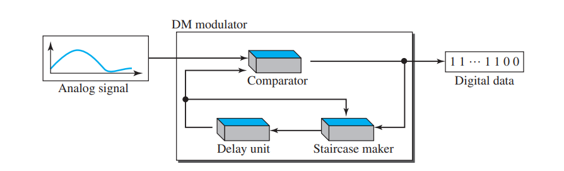
Demodulator
The demodulator takes the digital data and, using the staircase maker and the delay unit, creates the analog signal.
The created analog signal, however, needs to pass through a low-pass filter for smoothing

